Slide 1
SIGNIFICANCE OF HISTORY TAKING IN HOMOEOPATHIC CASE TAKING
Dr. P. R. Sisir
Dept. of Repertory,
Sarada Krishna Homoeopathic Medical College

Slide 2
INTRODUCTION
“DIAGNOSIS SHOULD PRECEDE TREATMENT WHENEVER POSSIBLE”
There are two steps in making a ‘Diagnosis’
Observation by HISTORY TAKING, Physical Examination & Ancillary Investigation.
Interpretation of information obtained in terms of a disorder of function & structure, and then in terms of Pathology.

Slide 3
In Practice,
* Patients do not come with a Diagnosis;
they come with ‘problems’.
* A wise doctor should be an ‘Elucidator of Human problems’ than a Diagnostician!
* The aim is to get from the person an accurate account of his complaint and to see this against the background of his life as a whole.

Slide 4
The Findings shall be recorded as follows:-
PRESENTING COMPLAINTS
(Location, Sensation, Modalities & Accompaniments)
HISTORY
PRESENTING PREVIOUS FAMILY PERSONAL
ILLNESS ILLNESS

Slide 5
* In taking the History it is neither possible to nor desirable to tie a patient down to any particular sequence.
* He must be allowed to tell his story in his own way.
* A ‘good doctor’ begins the examination of a patient as he walks into the room & only finishes taking the history when the consultation is over.

Slide 6
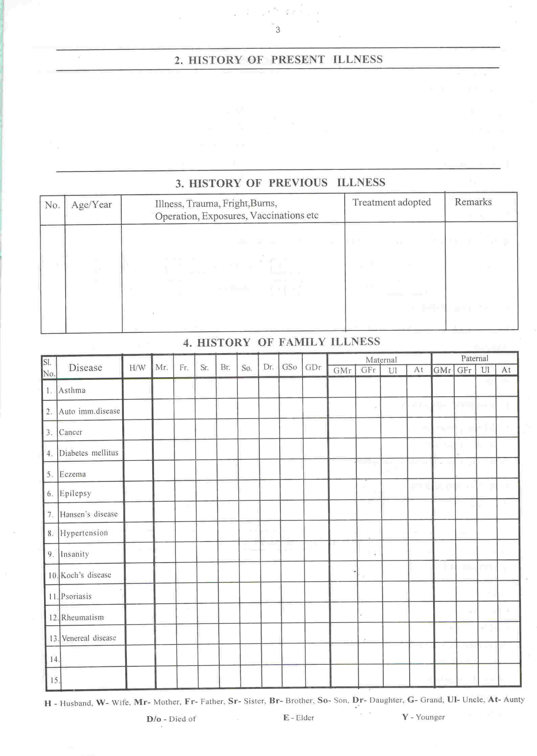
PRESENTING COMPLAINTS

Slide 7
HISTORY OF PRESENTING COMPLAINTS
Ask the Patient to tell the story of his illness from the beginning.
WRITING OUT THE HISTORY
Aim is to write a complete yet ‘concise’ record of the history of presenting complaints.
Let us see some cases …

Slide 8
Falling of hairs on the scalp in patches
Head, scalp Falling off hairs in patches < night,
(2 yrs) Itching+ < while perspiring,
< summer, sun
THIS PT. SAYS THAT: “DOCTOR , I BELIEVE THAT THIS FALLING
OF HAIR STARTED SINCE I GAVE BIRTH TO MY SON, 2 yrs. BACK!”

Slide 9
HISTORY OF PRESENTING COMPLAINTS
Hair Fall dvlpd. since dlvry , 2 yrs. back.
* SIGNIFICANCE OF THE ABOVE FINDING BECOMES PROMINENT WHEN THE
CASE DOES NOT SHOW ANY POSITIVE IMPROVEMENT WITH THE ROUTINE
PRESCRIPTION BASED ON SYMPTOM TOTALITY!
Lycop., Sulph., canth., carb.veg., nat. m., nit. ac., sep. etc.
may help to cure the case when the well selected remedy fails to act or
remains as an obstacle for cure.
?
?

Slide 10
Itching eruption
Head, Scalp Itching with pustular < summer, warmth
4 yrs eruption, yellowish scratching,
offensive, watery eating egg,
Sticky discharges dry fish
> cold bathing, winter
THE PT. SAYS THAT THE ERUPTION IN THE BEGINNING WAS
TREATED BY A SKIN SPECIALIST WITH OINTMENTS AND WAS
COMPLETELY RELIEVED!

Slide 11
HISTORY OF PRESENTING COMPLAINTS
Eruptions on scalp 1st apprd. 4 yrs. bk.; tretd. with ext. oint.,
got relief.
* SIGNIFICANCE OF THE ABOVE FINDING BECOMES PROMINENT WHEN THE
CASE DOES NOT SHOW ANY POSITIVE IMPROVEMENT WITH THE ROUTINE
PRESCRIPTION BASED ON SYMPTOM TOTALITY!
SKIN
ERUPTIONS
suppressed: Bry., Dulc., Ip., Petr., Ph-ac., Psor., Stram.,
Sulph., Zinc. (3 Knt.)

Slide 12
Cough
Chest Cough hacking
(15 yrs) has to spit sputum often
expectoration difficult < sleep, 10 p m – 5 a m
Breathing difficult , short > spitting phlegm
inspiration, prolonged > sitting up
expiration.
THIS PT. NARRATED THAT HE WAS EXPOSED TO A VENEREAL INFECTION
WHICH WAS TREATED BY A SKIN SPECIALIST WITH INJECTIONS AND TABS
FOR A PERIOD OF 1 MONTH. HE WAS FREE FROM THE INFECTION.
FEW DAYS AFTER THAT HE STARTED DEVELOPING COUGH FOLLOWED
BY BREATHING DIFFICULTY WHICH WAS TREATED WITH ALLOPATHIC
DRUGS IN VAIN.

Slide 13
HISTORY OF PRESENTING COMPLAINTS
Pts. Complnt. started following Allopathic med. for Venereal dis. 15yrs. bk.
Contd. Allopathic med. for resp. ailments.; no relief
SIGNIFICANCE OF THE ABOVE FINDING
REFER - KENT REP. (791) . When the well selected remedy fails to act!
COUGH
GONNORRHOEA
suppressed, after: Benz-ac., med., sel., thuj

Slide 14
HISTORY OF PREVIOUS ILLNESS

Slide 15
HISTORY OF PREVIOUS ILLNESS
PRESENTING COMPLAINTS
Ask the Patient to tell the story of his previous illness from the beginning.
.
WRITING OUT THE HISTORY
* Aim is to write necessary yet ‘concise’
record of the history of previous illness.
* Column no.1 is to be used to write down
the no. of the appearance of illness right
since childhood.
* Column no. 2 for age / year of
occurrence of the previous illness in
chronological order.
* Column no. 3 for the type of illness
* Column no. 4 & 5 - treatment adopted
for each condition followed by its result
respectively.

Slide 16
Eg.:- 1
A PATIENT 35 yrs. male, SUFFERING FROM CHRONIC HEADACHE
WAS TREATED WITH MEDICINES AS PER THE SYMPTOM TOTALITY
SHOWED NO RELIEF IN SPITE OF CHANGING THE
POTENCIES / REMEDIES, AS PER RULES!
ON EXAMINING THE PREVIOUS HISTORY, HE HAD AN ACCIDENT WITH HIT
ON HEAD (OCCIPITAL REGION) 2 YRS. BACK!
WRITING OUT:
HISTORY OF PREVIOUS ILLNESS
-
1.
34 yrs.
Trauma, Head
First –aid &
obsv. for 48hrs. in a
Hosp. IPD
No complications
SIGNIFICANCE:
For the after-effects of head injury there are a group of remedies – ARNICA, Cicuta,
Hypericum, Nat.mur, NAT.SULPH., Helleborus.
ANY OF THE ABOVE DRUGS , Esp. ARNICA or NAT. SULPH. WILL CURE THE
PATIENTS HEADACHE IF THERE ARE NO OTHER OBSTACLES OF CURE!

Slide 17
Eg.:- 2
DIRECTLY ANTIDOTING SOME EPISODE OF THE PAST
A woman of 34 developed Ulcerative colitis. Her constitutional remedy was Sepia, which she was given with some benefit, but not as much as one could expect.
Higher potencies were given as the indications for Sepia seemed absolutely clear, but the results were not satisfactory.

Slide 18
Then on Family History and
Complimentary relationship
between Sepia & Carcinosin,
a dose of Carcinosin 200 was given,
but again without any dramatic effect !

Slide 19
On examining her Past History she attributed to a fall in which she hurt her back nine months previously.
HYPERICUM 30, 200, 1M on consecutive days was given and a month later she said “I am cured.”
Courtesy – Dr. Foubister ( Richard Hughes Memorial Lecture)

Slide 20
AILMENTS FROM GRIEF
A boy of 15 yrs. Had suffered from Enuresis since the age
of 3 yrs. He had been dry at 18 months but reverted to bed
wetting when his mother was admitted to Hospital.
Many treatments were taken in vain before he came to
Homoeopathy.
The boy was grossly over weight and had other
symptoms suggesting GRAPHITES, which is one of the
remedies for “effects of grief”.
He was given Graphites 1M. There was an aggravation for
one week followed by relief for few months, and a second dose
was given following a relapse.

Slide 21
CONSTITUTIONAL TREATMENT
Constitutional Homoeopathic treatment consists mainly of prescribing on the psychosomatic make-up of the patient and on the PAST HISTORY.
Quite often the Psychosomatically selected remedy can cover outstanding episodes in the past, for eg:- Nat. mur when the patient has had Concussion.
But sometimes it is necessary directly to antidote some past event which greatly disturbed patients health.

Slide 22
If psychosomatic prescribing fails to produce satisfactory results, the past history may lead to an appropriate remedy for that individual, or it may be advisable to prescribe on the family or individual history when there are no clear symptomatic indications for any remedy right from the beginning.

Slide 23
PAST HISTORY-CURING “AFTER EFFECTS OF…”
The evil consequences of coffee & wine drinking -- Nux vom
(Hahnemann)
Patients upset by over doses of iron -- Pulsatilla
Prolonged drugging with Quinine -- Nat. mur
Bad effects of Turpentine -- Terebinthina
Exposure to excessive radiation -- X-ray,
Rad. brom.
llness due to menarche -- Pulsatilla
Ill-health after menopause -- Lachesis
Bad effects of vaccination -- Maland., Sil., Sulph., Thuja

Slide 24
HISTORY OF FAMILY ILLNESS

Slide 25
HISTORY OF FAMILY ILLNESS
Ask the Patient to tell the Diseases
suffered / suffering by her close
relatives & its remarks.
The squares corresponding to the
disease & the affected member is to be
marked accordingly.
PRESENTING COMPLAINTS

Slide 26
In making a Psychosomatic Homoeopathic
prescription or a prescription based on the individual’s past
history, the patient is regard against a background of a
theoretical norm.
The same applies to “Family History” too.
If there is a strong history of Tuberculosis or Cancer in the
Family, the appropriate Nosodes deserve consideration.

Slide 27
IF WE KNOW THE DETERMINING CAUSE AND THE
REMEDY EXACTLY HOMOEOPATHIC TO THE CAUSE,
MANY MORE BRILLIANT RESULTS WOULD BE
ACHIEVED.
CAUSES
PREDISPOSING EXCITING
Hereditary is the main factor
Tuberculosis
Insanity
Menstrual Headache
Epilepsy
Diabetes mellitus, etc.
“ REMOVE THE EFFECTS AND REMOVE THE DISEASE,
THE CAUSE OF THE EFFECTS”
- Dr. Hahnemann

Slide 28
A Case: -
Pt. aged 27/ (F), unmarried; sanguine, nervous temperament; short & stout when in health; brown eyes, brown hair.
Has had Epileptic fits for 11 yrs.
Frequency of attacks controlled by a Neurologist.
F/H – Mr. D/o Tuberculosis.
Other complaints:-
Can’t eat anything.
Mouth tastes very badly; < in the morning
Smell of cooking food nauseates
Cough (++) < night
Soreness in middle of chest, behind sternum, < Coughing, Ascending hill
Loosing weight since 6 mnths
Backache
Pulse 100 to 120 all the time!
Sweaty nights.
Greatly depressed & cries easly
?
?

Slide 29
PRESCIPTION No. 1 ---- PULSATILLA 200
PRESCIPTION No. 2 ---- PULSATILLA 1 M
PRESCIPTION No. 3 ---- PULSATILLA 10 M
ALL FAILED ! ?

Slide 30
Tuberculinum 1 M – 1D / mnth. for 4 mnths
Attack of seizures once in two weeks!
&
Then gradual recovery
Courtesy to Dr. E. B. Nash

Slide 31
CONCLUSION
Richard Hughes once said:
“THE RULE OF SIMILIA SIMILIBUS CAN OBVIOSLY BE CARRIED OUT ONLY IN PROPORTION AS THE EFFECTS OF DRUGS ON THE HEALTHY BODY ARE ASCERTAINED”.
THERE ARE DIFFERENT BASES OF SIMILARITY AND THERE IS NO REASON WHY DIFFERENT APPROACH TO HOMOEOPATHIC PRESCRIBING SHOULD NOT BE APPROPRIATELY UTILISED!

Slide 32
THANK YOU ALL

